Slide 1
Binary Trees

Slide 2
Advantages of Linked List
Dynamic data Structure .
Linked List can grow and shrink during run time.
Insertion and Deletion Operations are Easier
Efficient Memory Utilization
no need to pre-allocate memory
They can reduce access time and may expand in real time without memory overhead.

Slide 3
Disadvantages
Waste memory due to pointers requiring extra storage space.
Nodes in a linked list must be read in order from the beginning as linked lists are inherently sequential access
What about Mr Zebra.
Reverse traversing.
Singly linked lists are extremely difficult to navigate backwards
Doubly linked lists are somewhat easier to read, memory is wasted in allocating space for a back pointer

Slide 4

Consider a phone book
Page |  | Page Pointer Start page 45
45 | AA Auto | 49
49 | B Chen | 61
61 | Cabana
So to get to the Giles using a linked list I would need to
A page 45 then to B page 61 then C page 61 then ????
Slow

Slide 5
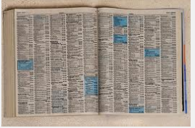
a b c d e f g h i j k l m n. o p q r s t u v w x y
What if I opened the at the M’s
I am in the middle
I know Giles is in the first half

Slide 6
a b c d e f g h i j k l m n. o p q r s t u v w x y
Now Take the middle again
That would give me f
I know Giles is in the second half

Slide 7
a b c d e f g h i j k l m n. o p q r s t u v w x y
Now Take the middle again
That would give me i
I know Giles is in the first half
etc

Slide 8
a b c d e f g h i j k l m n o p q r s t u v w x y
This is the idea of the binary tree

Slide 9
Consider the following list

Slide 10

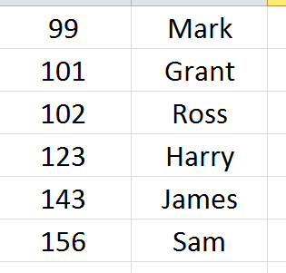
Consider the following list
Start with Mark

Slide 11
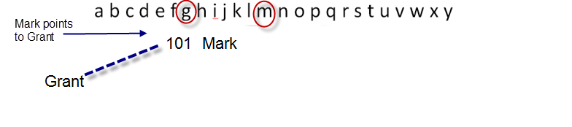
Consider the following list
Now consider Grant comes before Mark in the alphabet

Slide 12
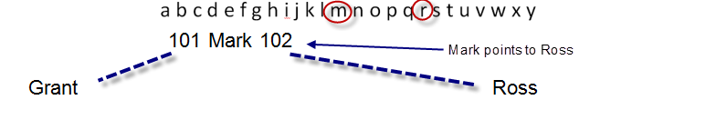
Now consider Ross comes after Mark

Slide 13
Binary Tree
Each name can only have two pointers
Before and after
So Mark is full

Slide 14
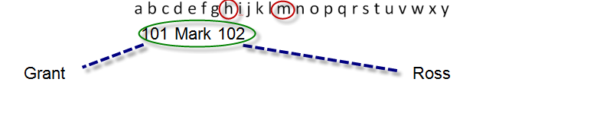
Now consider Harry comes before Mark

Slide 15
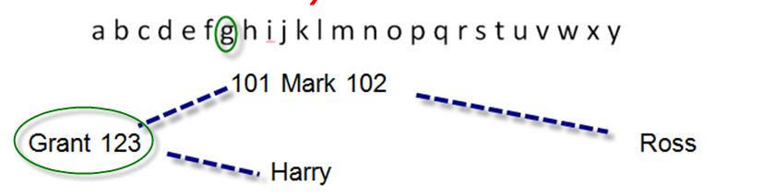
Now consider Harry comes after Grant

Slide 16
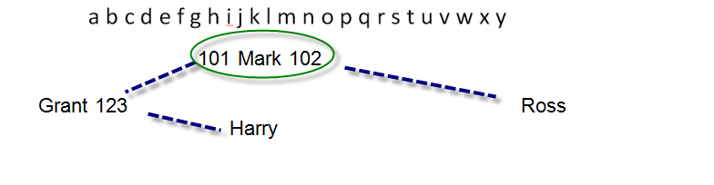
Now consider James comes before Mark

Slide 17
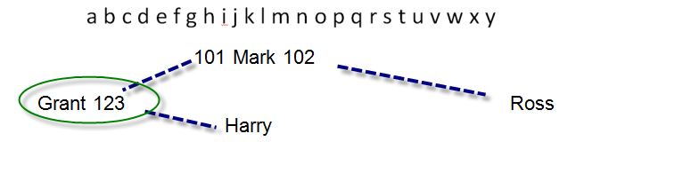
Now consider James comes after Grant

Slide 18
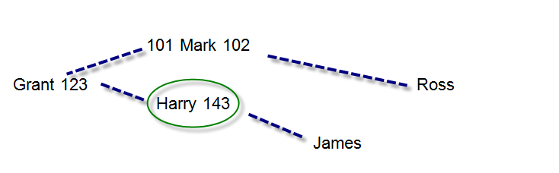
Now consider James comes after Harry

Slide 19
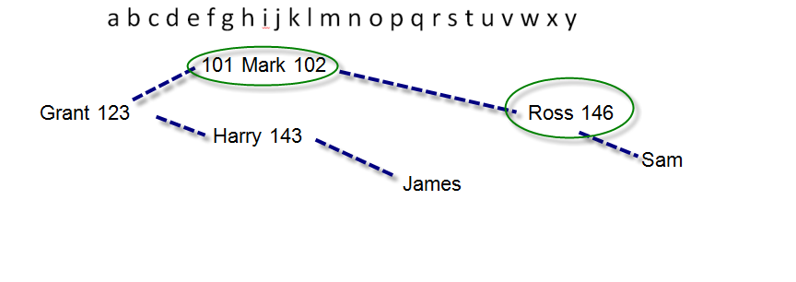
Finally Sam
After Mark
After Ross

Slide 20
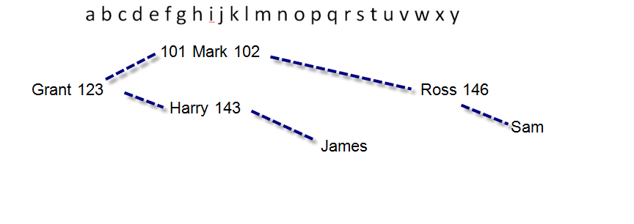
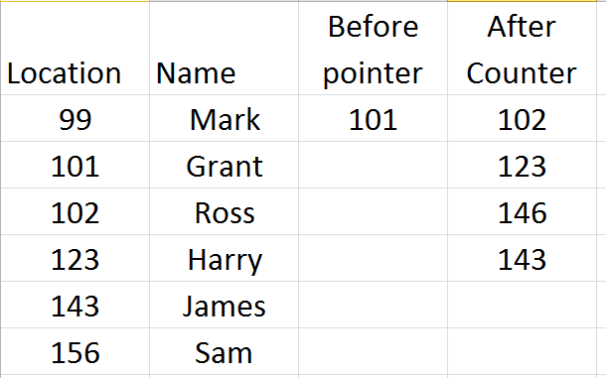
Now read the tree

Slide 21
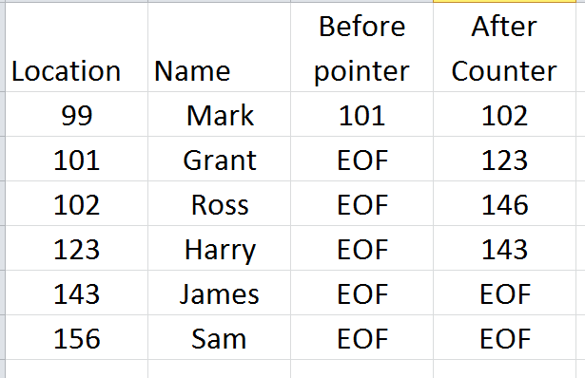

Slide 22
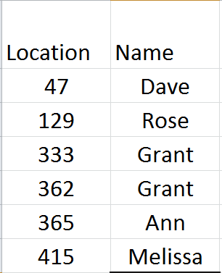
Example two
Start with Dave

Slide 23
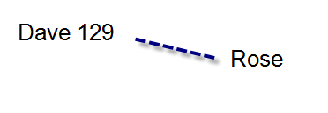
Example two
Rose comes after Dave

Slide 24
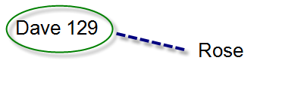
Example two
Grant comes after Dave

Slide 25
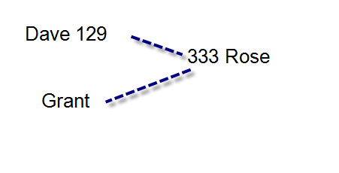
Example two
Grant comes after Dave
Before Rose

Slide 26
Example two
Likewise the second Grant
Comes after Dave
Before Rose

Slide 27
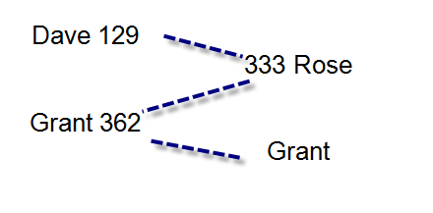
Example two
Likewise the second Grant
Comes after Dave
Before Rose
After the first Grant

Slide 28
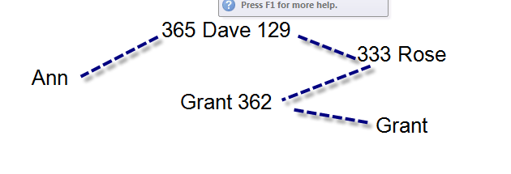
Example two
Ann comes before Dave

Slide 29
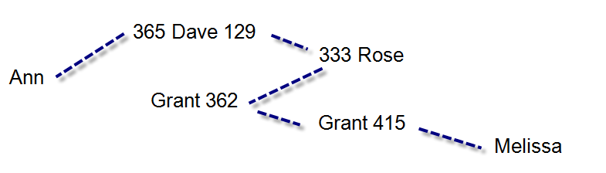
Example two
Melissa comes Dave Before Rose After Grant
After Grant

Slide 30
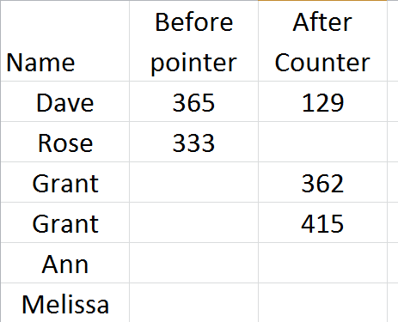
Example two
Again read the tree

Slide 31
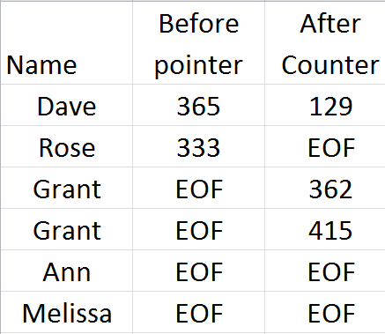
Example two
Again read the tree

Slide 32
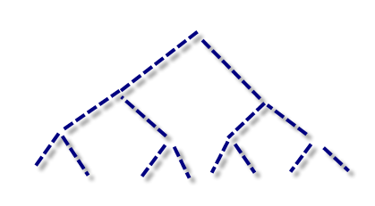
This what we call unbalanced tree
Binary Trees work best when they are balanced

